Slide 1
RUNGTA COLLEGE OF DENTAL SCIENCES AND RESEARCH
CASTING PROCEDURES DEFECTS AND METHODS OF COMPENSATION
DEPARTMENT OF CONSERVATIVE DENTISTRY AND ENDODONTICS

Slide 2
Specific learning Objectives
At the end of this presentation the learner is expected to know ;
Core areas* | Domain ** | Category #
Introduction, steps in casting, casting defects | Cognitive | Must know
Definitions, porosity | Psychomotor | Nice to know
Die materials, recent advances in casting | Affective | Desire to know

Slide 3
Contents.....
Introduction
History
Glossary of Prosthodontic terms
Basic cavity designs
Die Materials
Wax Pattern
Sprue Design
Casting Ring/ liners
Investments and procedures
Burn Out procedure
Casting Machine and Crucible
Ringless casting system
Casting Defects
Methods of Compensation
Recent Advances
Conclusion

Slide 4
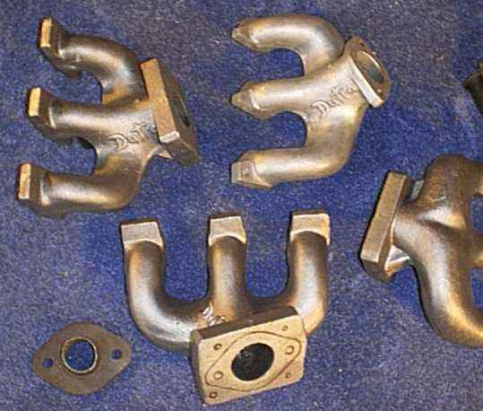
Casting Procedures
Defects and the
Methods of
Compensation
Casting Procedures
Defects and Methods
of Compensation
T.S.Vinoth kumar
PG Student

Slide 5
Introduction
Perfect adaptation to the tooth structure.
An unsuccessful casting can result in loss of time and trouble to the operator.
Casting defects in most cases can be avoided by strictly adhering to the rules and principles of casting procedures.
Proper cavity design and crown preparation, a good & accurate die, proper waxing and investment procedures are all very important steps to attain a good casting

Slide 6
Definition
The process by which a wax pattern of a restoration is converted to a replicate formed by solidification of a dental alloy in its fluid form, that has been poured or injected into a mold.

Slide 7
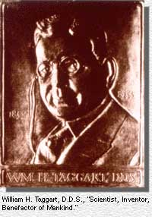
History
11th Century → Theophilus → Described lost wax technique, which was a common practice among the jewellers
1558 → Benvenuto Cellini → claimed to have attempted use of wax and clay for preparation of castings
1884 → Agulihon de saran used 24K gold to form Inlay.
1887 → J. R. Knapp → Invented Blowpipe
1897 → Phillibrook described a method of casting metal filling.
1907 → Taggart → devised a practically useful pneumatic pressure casting machine.

Slide 8
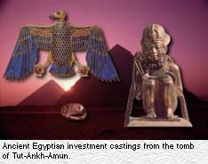
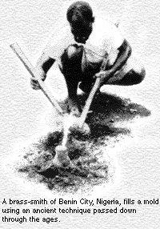
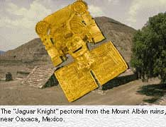
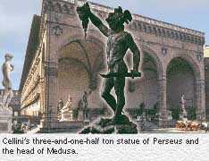

Slide 9
GPT - Terminology
Casting : n → something that has been cast in a mold ; an object formed by the solidification of a fluid that has been poured (or) injected into a mold
verb → The act of forming an object in a mold.
Crucible → A vessel / container made of any refractory material (as porcelain) used for melting / calcining any substance that requires a high degree of heat.
Crucible former → The base to which a sprue former is attached while the wax pattern is being invested in refractory investment ; a convex rubber, plastic / metal base that forms a concave depression / crucible in the refractory investment.

Slide 10
Sprue → The channel / hole through which plastic / metal is poured / cast into a gate / reservoir and then into a mold.
Sprue buttons → The material remaining in the reservoir of the mold after a dental casting.
Sprue former → a wax, plastic or metal pattern used to form the channel / channels allowing molten metal to flow into a mold to make casting.
Pickling → To treat, preserve/clean in (or) with an agent.
Mold → a cavity in which a substance is shaped, as a matrix for casting metal/ plastics,
A negative form in which an object is cast / shaped.

Slide 11
Cast Metal Restorations
Intra Coronal Restorations
Intra radicular restorations
Inlays
Onlays
Cast Post
Extra coronal Restorations
Full Veneer Crowns
Full Metal Crowns
Metal Ceramic Crowns
Partial Veneer Crowns

Slide 12
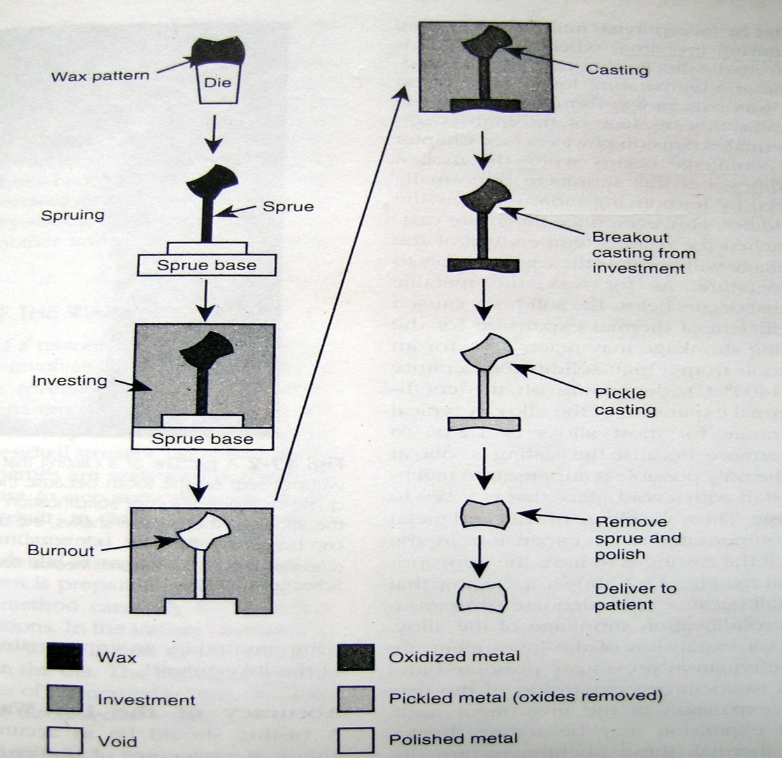
Lost wax technique

Slide 13
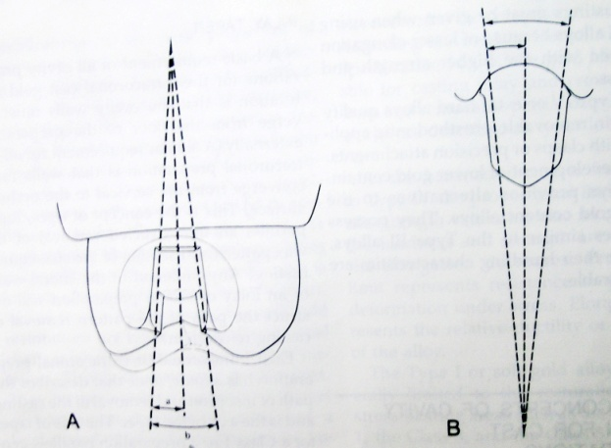
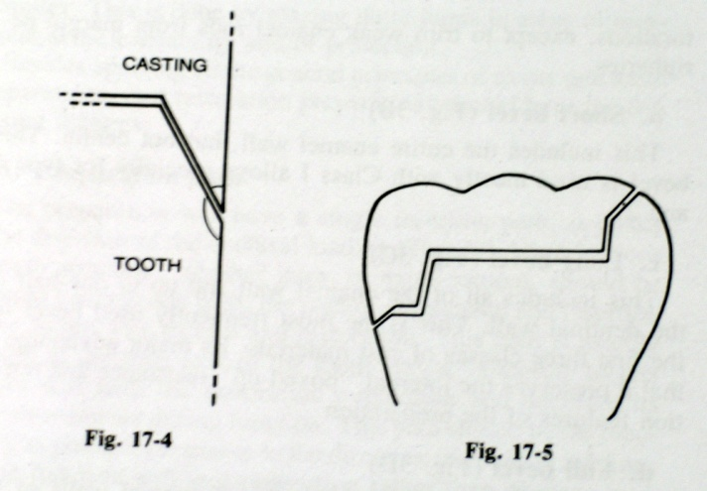
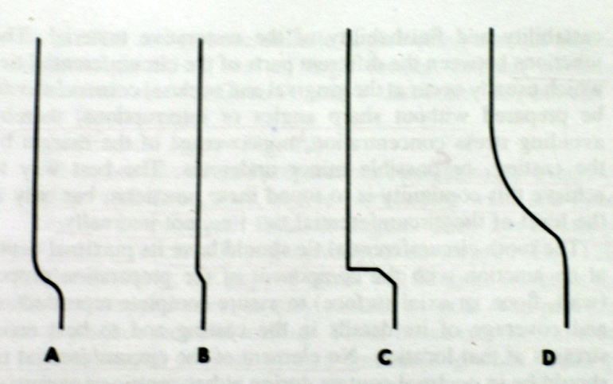
Basic cavity designs
Preparation path
Taper
Circumferential tie
Intracoronal
Extracoronal

Slide 14
Die materials
Gypsum
Type IV dental stone
Type V dental stone, high strength, high expansion
Type V dental stone + ligho sulphonates (wetting agent)
Metals and metal coated dies
Electroformed
Sprayed metals
Amalgam
Polymers
Metal or inorganic filled resins
Epoxy resins
Cements
Silicophosphate or poly acrylic acid bonded cement
Refractory materials
Divestments

Slide 15
Wax Pattern
CASTING WAX-
A composition containing various waxes with desired properties for making wax patterns to be formed into metal castings (GPT)
A mixture of several dental waxes, usually containing paraffin wax, ceresin, beeswax, resins, and other natural and synthetic waxes. It is used for making patterns to determine the shape of the metallic framework and other parts of removable partial dentures. (From Jablonski's Dictionary of Dentistry, 1992, p868)

Slide 16
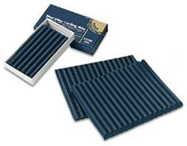
The ANSI/ADA Specification No. 4 (ISO 1561) for Dental inlay casting wax
Type I – Medium wax – Direct technique
Type II – Soft wax – Indirect technique

Slide 17
Desirable properties….
Should be uniform when softened
Colour contrast with the die material
Should not be flaky when bent and molded after softening
Should not chip or get pulled away during carving
Should not leave any residue after the burn out procedure

Slide 18
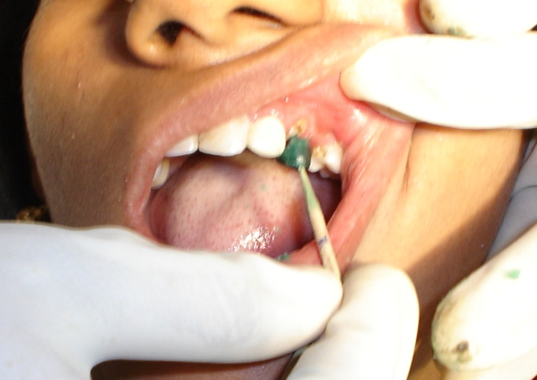
Direct wax pattern
Type I wax – flow
No lubricant – saliva and dentinal fluid
Adequate flow and plasticity under compression
Over heating should be avoided
Carved with warm instruments
Working temperature 50-52°C – Stress free piece of wax
Dry heat oven – uniform heating and annealing
Bunsen burner – non uniform consistency and volatalization
Annealing in water at proper temp. – prolonged – crumbly mass
Hooked with the explorer , Staple pin or loop of thread for
MOD and later with dental floss

Slide 19
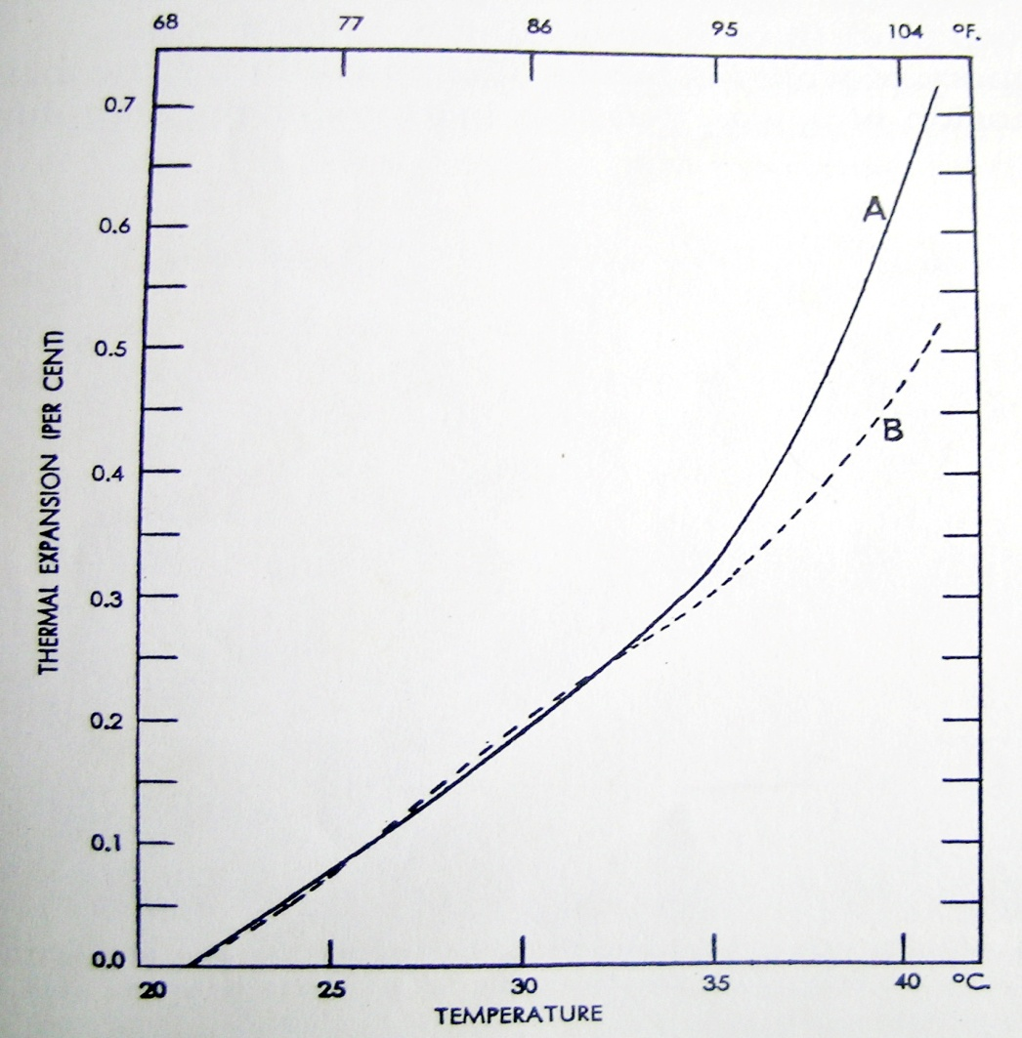
Thermal expansion of inlay
wax
Increase of 20°C – expansion of 0.7%
Wax held under compression during
cooling in the cavity
T_{g}
Thermal coefficient of expansion is
350 X 10 ⁻⁶ / ° C

Slide 20
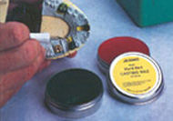
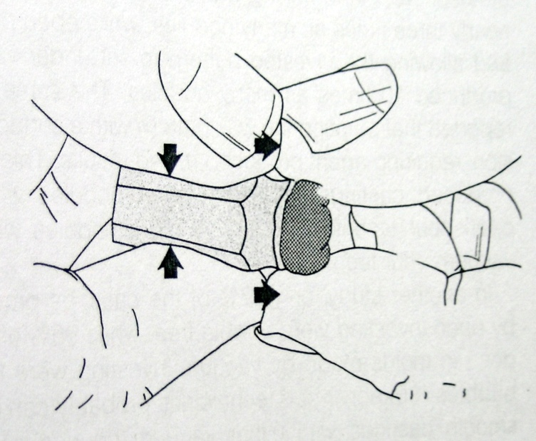
Indirect wax pattern
Metal or stone die
Type II wax – flow is less critical
Die spacer – 10–30 μ
Lubricant
Melted wax added in layers or painted,
carved and polished with silk cloth
Compression can also be done
Temperature of metal die – Critical
Electric lamp or electric heating pad at suitable temp

Slide 21
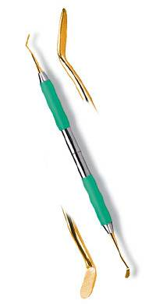
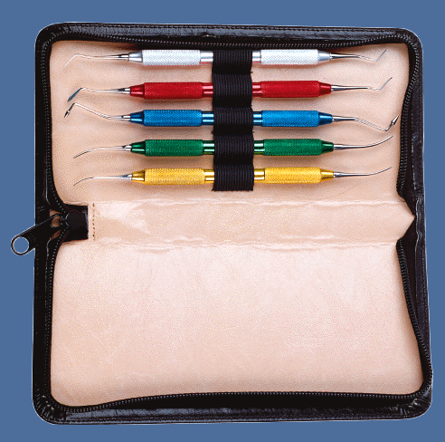
Margin Carver PKT instruments

Slide 22
Sprue Design
GPT - The channel / hole through which plastic / metal is poured / cast into
a gate / reservoir and then into a mold.
Factors affecting the dimensions of sprue or sprue former are ….
Type and Size of the pattern
Type of casting machine
Dimension of the ring

Slide 23
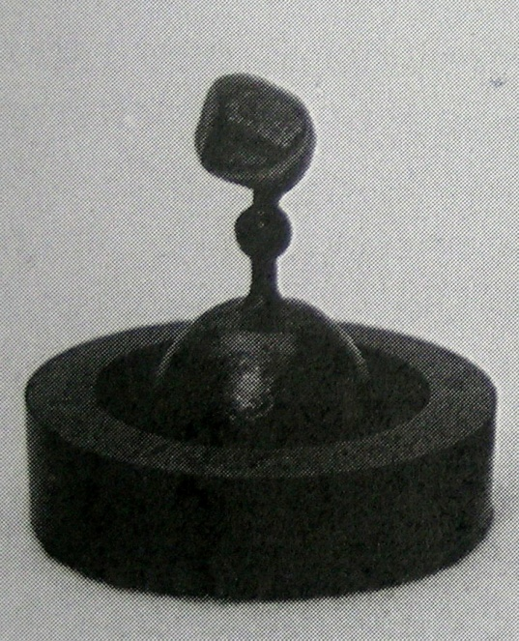
Direct spruing
A straight sprue former is luted (attached) to the thickest part of the wax pattern at one end and secured to the crucible former at the other.
The flow of molten metal is straight (direct) from
the casting crucible to the pattern area in the ring.
Requires less time and effort.
Direct spruing is used most frequently for single
units patterns
A basic weakness of direct spruing is the potential
for suck-back porosity at the junction of restoration
and the sprue

Slide 24
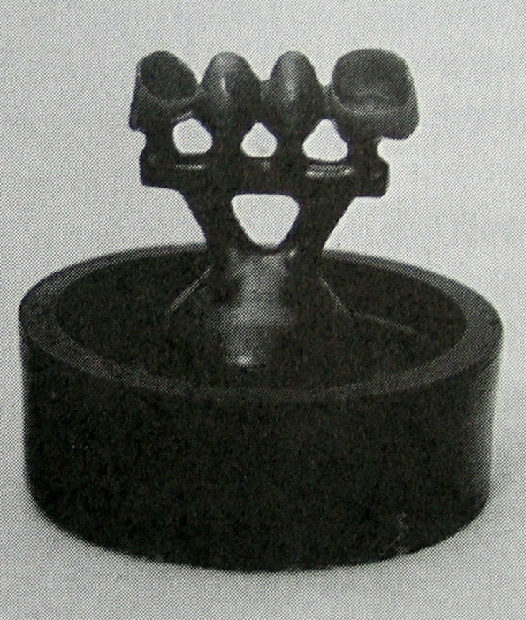
Indirect spruing
The casting alloy takes a circuitous (indirect)
route before it reaches the pattern areas, thus the
name indirect spruing.
The connector (or runner) bar is often 6- or 8-gauge round wax to which the wax pattern sprue formers are attached on one side with two larger ingot sprue formers on the other side,
Manifold – 10 gauge
Advantages
greater predictability and reliability in casting
Enhanced control of solidification shrinkage

Slide 25
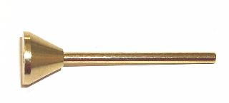
Sprue formers
GPT - A wax, plastic or metal pattern used to form the channel / channels
allowing molten metal to flow into a mold to make casting.
Wax
Plastic
Metal - Hollow and Solid

Slide 26
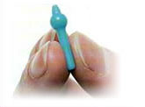
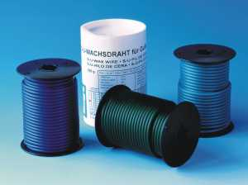
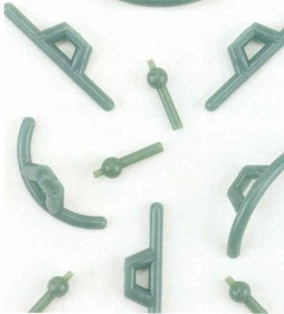
Prefabricated sprue formers
To meet the needs of individual cases.
To obtain a predictable and time­saving method of spruing.
Wax wires

Slide 27
Sprue former placement
Attachment can be done only when when wax pattern can be removed, flared for high density alloy and restricted for low density alloy
The sprue former attached to the thickest part of the pattern
(Flow of molten metal from thick section to thin areas)
With thin anterior copings the most practical sprue location is the mid incisal area.

Slide 28
Sprue former gauge
A pattern sprue former of sufficient size should be selected to supply the volume of alloy required of the patterns to be cast.
The round wax sprue formers are conveniently identified with a gauge number (ie, 10, 8, 6).
Double or same as the thickest area of the wax pattern
The larger the number, the smaller the sprue formers diameter.
Alloy manufacturers invariably include size recommendations with their alloys
With indirect spruing, the reservoir should be equal to or larger than the thickest cross-sectional area of the largest pattern.

Slide 29
Sprue former position
Occlusal surface
Proximal
Below the non functional cusp
Ideal area – point of greatest bulk

Slide 30
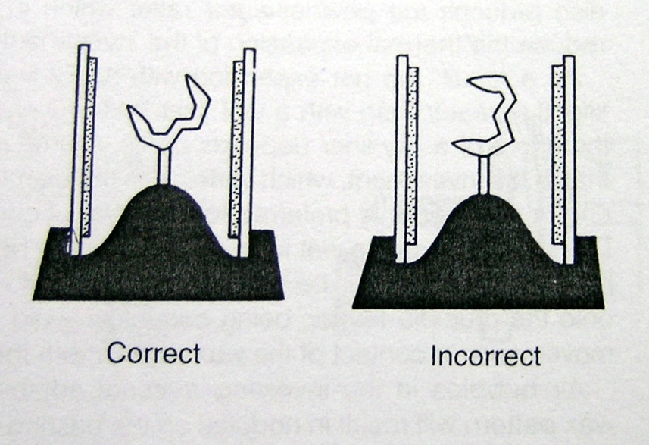
Sprue former direction
Directed away from thin delicate parts of the pattern
Should not be attached at right angles

Slide 31
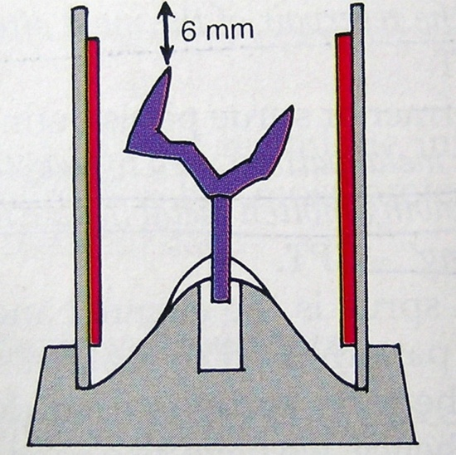
Sprue former length
With the direct spruing method, the sprue
former should be long enough to position
the wax patterns outside the heat center of
the ring and into a cold zone
The actual length of the sprue former will vary with the type and size of the crucible former and the casting ring used.
Top of the wax pattern should be within 6mm of the open end of the ring ( 3 to 4 mm for phosphate bonded investment) - Venting of gases

Slide 32
Sprue former length (contd)
With indirect spruing pattern placement off the connector bar is recommended to ensure location of the patterns outside the thermal zone, or heat center of the investment.
5-mm­long pattern sprue former is often sufficient to meet this requirement
Incomplete castings may occur if the wax patterns are positioned too far from the connector bar, because alloy may solidify in the sprue channel before the pattern has filled completely.

Slide 33
Orientation of the wax pattern
The casting of an otherwise properly sprued pattern can be jeopardized if the pattern is not correctly oriented in the casting ring.
Avoiding sharp 90-degree angles between the sprue former and the wax pattern or position the pattern so the alloy would have to flow back toward the ring entrance.
It is essential to take advantage of centrifugal and gravitational forces by positioning the wax pattern such that the alloy is cast toward thinner sections, such as the margins.

Slide 34
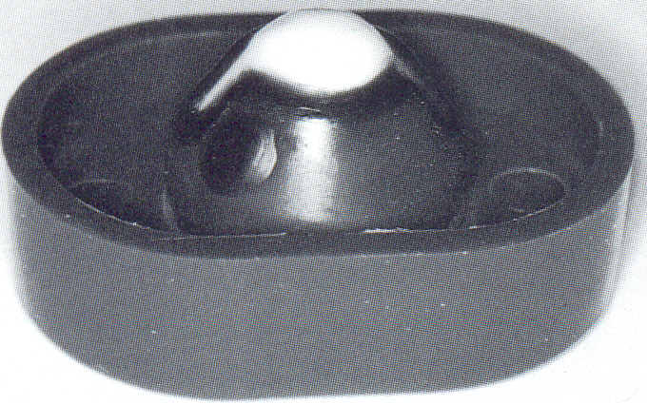
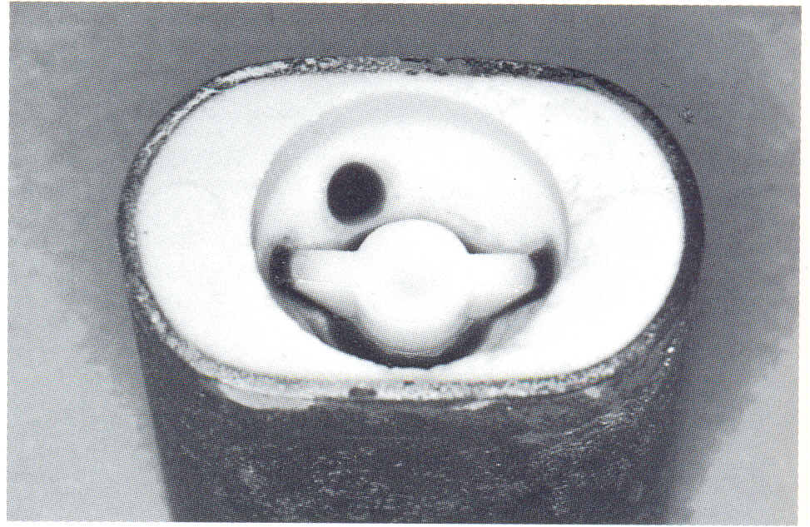
Orientation of the wax pattern
This is accomplished by positioning the margins of the patterns to the edge in the casting ring.
Before investing the patterns, a wax dot is placed on the crucible former to provide an orientation reference after the patterns have been invested .

Slide 35
Location of the reservoir
The reservoir portion of a spruing system, be it a 6-, 3-, or 1-gauge bar or round ball, should be positioned in the heat center of the ring
This permits the reservoir to remain molten longer and enables it to furnish alloy to the patterns until they complete the solidification process
Aside from being in the heat center, the reservoir should have the largest mass of any part of the sprue system.

Slide 36
Constricted spruing
Tapering the sprue former at its attachment to the wax pattern rather than flaring this area is referred to as "constricted spruing"
The taper is to permit the sprue former to function like a true reservoir, thereby decreasing the likelihood of suck-back porosity.
The constriction may be helpful in the mold-filling process for lower density base metal alloys.
But, as the density of the metal increases, it is likely to interfere with mold filling and lead to increased poros­ity
Therefore, it is recommended that the greater the alloy density, the greater the sprue -pattern access.

Slide 37
Sprue former composition: wax versus plastic
Plastic sprue formers do not burn out completely through the lower temperature range - greater potential for carbon residue
Plastic undergoes more expansion before softening than does wax, a characteristic that may be responsible for investment cracking.
If the molten wax is blocked by un melted plastic, the wax may overheat (boil), and erode the inner surface of the mold - surface roughness.
Manufacturers of plastic sprue formers recommend applying a layer of wax over the entire surface of the plastic sprue former to produce an escape mechanism for the melting wax patterns

Slide 38
Sprue former composition: wax versus plastic
Increase the irregularities in the investment if the wax is not flowed evenly and smoothly over the plastic components.
Therefore, a two-stage burnout is recommended for plastic sprue formers with a 30 minute heat soaking at 800°F (427°C) for the first stage.
When the oven reaches this temperature, burnout for 30 minutes (single ring), then reset the oven to the desired high temperature and continue wax elimination (burnout).

Slide 39
Warpage of patterns
Residual Stress – uniform softening by heating at 50 °C for 15 min
Temperature and Time –
Higher storage temperature, greater the warpage
Lower temperature reduce the warpage
If > 30 minutes - Stored in a refrigerator
Best method is to invest the pattern immediately

Slide 40
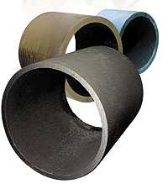
Casting ring
GPT – The inferior portion of a retractory flask that provides a negative
likeness or dimple into which a metal is cast in the refractory investment
Metal – Stainless steel, 12% at 700°C
dia 29mm and ht 38mm
Plastic
Rubber

Slide 41
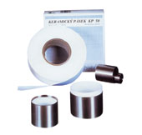
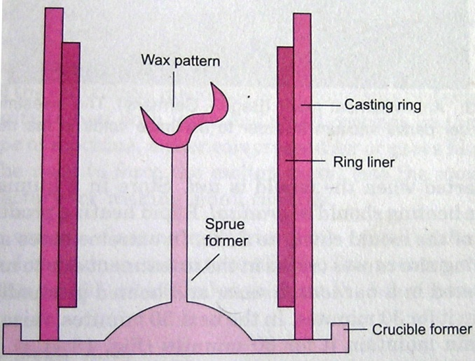
Casting liners
Asbestos - lung disease , carcinogenic
Non asbestos ring liner materials
ceramic (aluminum silicate),
cellulose (paper), and
a ceramic- cellulose combination
wax crinkled paper
20 m of tape 50 mm wide

Slide 42
TAKE HOME MESSAGE
Cast restorations meet the needs of patients who require, for one or more reasons, the replacement of a rather large amount of tooth tissue. The manner of casting fabrication, by the indirect or direct methods, material selection throughout the process and their manner of use is a choice for the experienced operator. Knowledge of the advantages and disadvantages of certain techniques and materials, thoughtful exercise of the basic principles guiding their application, and critical assessment of the results of practice will help assure the highest quality of this form of restorative care.

Slide 43
QUESTIONS
Define Cast metal restorations
Classify metals used in cast metal restorations
Discuss Ideal properties of metals in cat metal restorations
List various casting defects. Methods to overcome them.
Define Porosity….types and its prevention
Types of Cast Metal Restorations.
Inlay wax

Slide 44
REFERENCES
Science Of Dental Materials -----By ANUSAVICE, Skinners.
Restorative Dentals Materials 11th Edition By Craig.
Operative Dentistry 2nd Edition By Summit, Robbins, Schwarts

Slide 45
SUGGESTED READING
Science Of Dental Materials -----By ANUSAVICE, Skinners.
Restorative Dentals Materials 11th Edition By Craig.

Slide 46
Thank You

